Slide 1
Game Search Spaces: Inspiration and Component Parts
Simon Lucas

Slide 2
Automated Game Design: Main Steps and Challenges
Main steps:
Creating a search space for a set of games (or game levels)
Creating operators to choose points in the space, and also variation operators to choose points in some neighbourhood (e.g. a Mutation operator)
Evaluate points in the search space
In general, the final step (evaluation) is the hardest!
For a restricted set of games, we can write evaluation heuristics
Or measure the experience of AI bots …

Slide 3
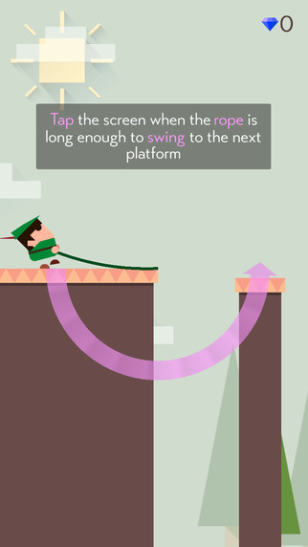
One-Touch Casual Games
Flappy Bird Phenomenon
Since then some good one-touch games
Retry, Mr Jump, Swing

Slide 4
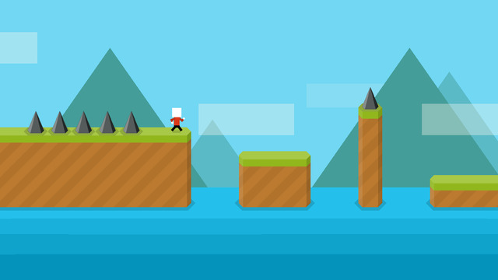
Mr Jump

Slide 5
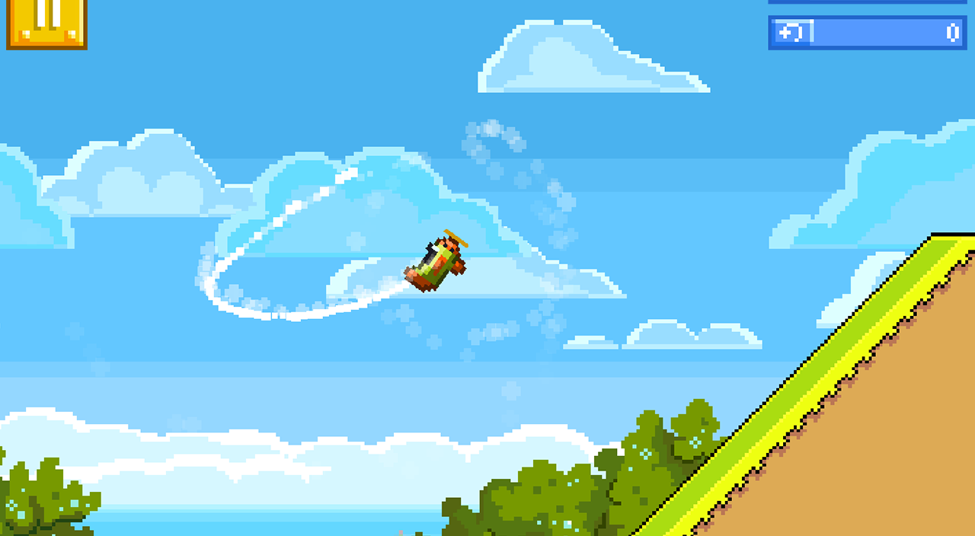
Retry

Slide 6
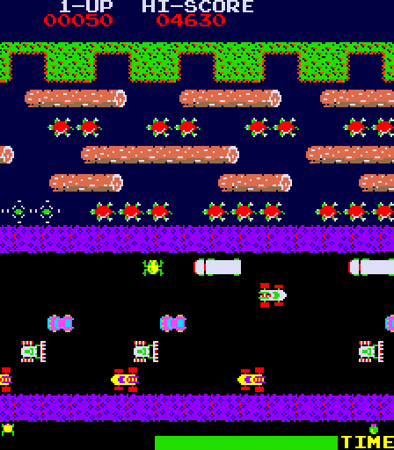
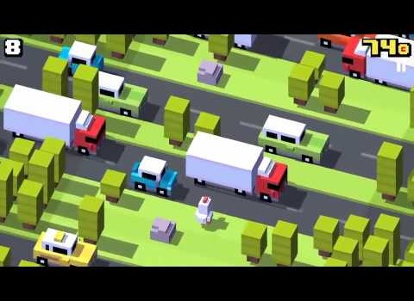
Plenty of “inspiration” out there…
Notes:
So many classic arcade games: interesting opportunities to breathe new life into them!

Slide 7
Observation
There are great opportunities for mining minor variations in existing games
Tuning the hell out of a format

Slide 8
Ambitious Searchable Design Spaces
Togelius and Schmidhuber (CIG 2008)
Cook and Colton (CIG 2011, …)
The above were ambitious in the open-ended nature of the rules – but the games had limited variations in the physics
Even more open-ended:
Video Game Description Language
Ebner at al Dagstuhl 2012, Schaul CIG 2013)
All interesting work
Difficult to auto-generate good quality human-playable games

Slide 9
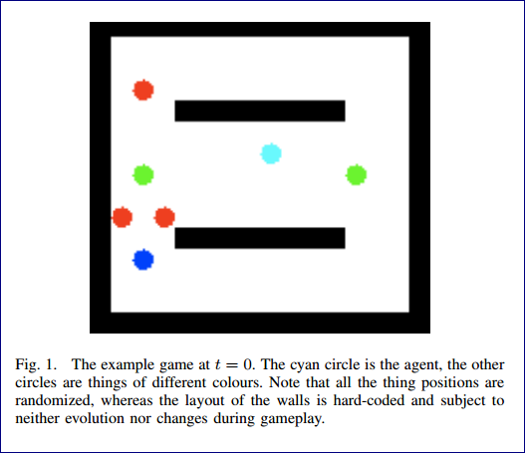
Togelius and Schmidhuber
Three items:
Set of numerical parameters
Table of collision effects
Table of collision scores
Evaluation was complex: how well could agents learn to play a game?
Inspiring work, but results were restricted by the cost of each fitness evaluation, and the learning ability of the algorithms
Current approach would more likely be SFP-based

Slide 10
The Devil is in the Detail
The big picture is important as well, BUT:
Tuning the details has a massive effect on playability of a game
We can separate out the identifying and setting of the detailed parameters
From measuring the effects of particular combinations of settings
The details can be hand tuned or automatically tuned
How can we measure the quality of a game?
Human play testing
Measuring experience of AI bots

Slide 11
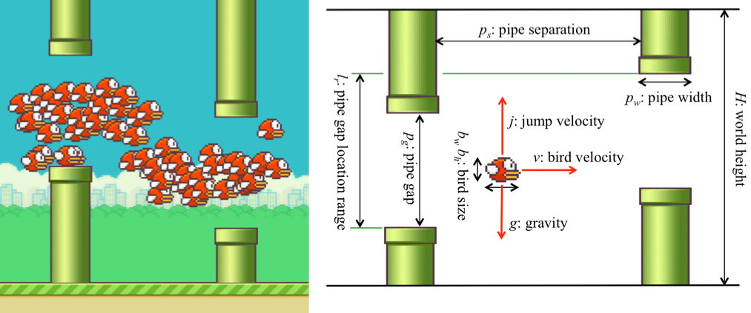
Searching a Flappy Bird Design Space (work by Aaron Isaksen et al @ NYU)
Interesting approach:
Identify a number of numerical parameters
Search for combinations of parameters that lead to playable games

Slide 12
What is a playable Flappy Bird game?
A simple but near optimal AI player is used with a small amount of random noise
The noise is used to vary the “tap time” (i.e. the exact game tick that the screen tap event is sent)
A playable game is defined as one where the percentage of “birds” achieving a minimum degree of progress is within a specified range

Slide 13
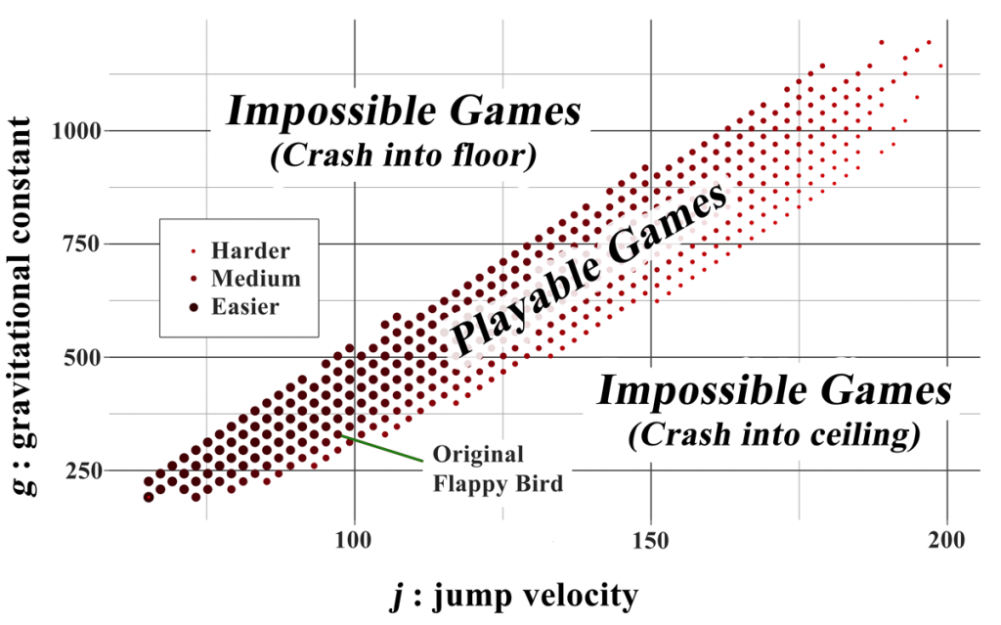
Searching the game space
After searching for playable games and clustering them
Different clusters led to games with a significantly different feel, even though the rules were the same
See link for more info

Slide 14
Comments on Isaksen’s Work
Excellent example of doing interesting work with simple AI
Uses games for which the development of an optimal or near-optimal AI is possible (perhaps even easy)
Then adds noise to the actions of the AI bots to simulate weaker play and human error
Noise can be added to vary the time
Can define the standard deviation of the added noise
Very cool!!!

Slide 15
Constructing a Searchable Game Design Space Approach: Identify Characteristic Dimensions of a Game Genre e.g. 2-D Arcade Games

Slide 16
Approach: Identify Characteristic Dimensions of a Game Genre e.g. 2-D Arcade Games
Game rules
Object types
Vehicle physics
Input controls
Weapon systems
Game views
Level designs
AI Behaviour

Slide 17
Game Rules
What happens when things collide? (define in Collision Matrix)
Reward structure (points, lives/health/ammo gained and lost)
Game state transition structure (e.g. when is a level cleared?)
These are fundamental to the nature of the game
Small changes can radically alter the game
For example, flipping the sign on a reward signal

Slide 18
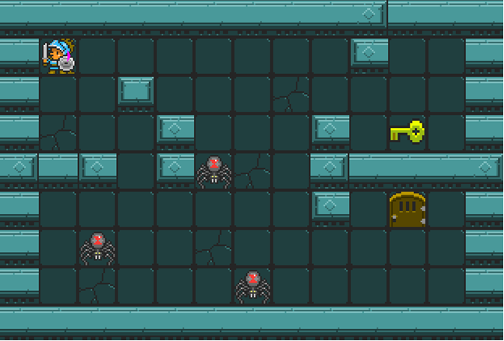
Object Types
Things to:
Shoot
Collect
For reward
Or power up / health
Jump on
Protect
Infect
Bounce off

Slide 19
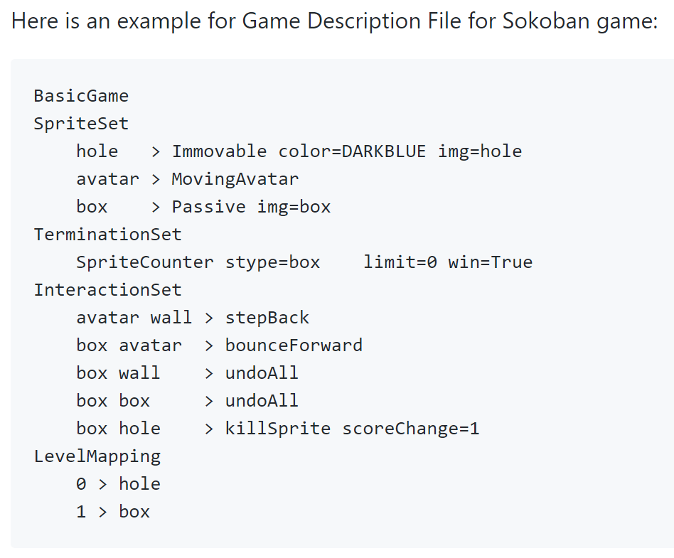
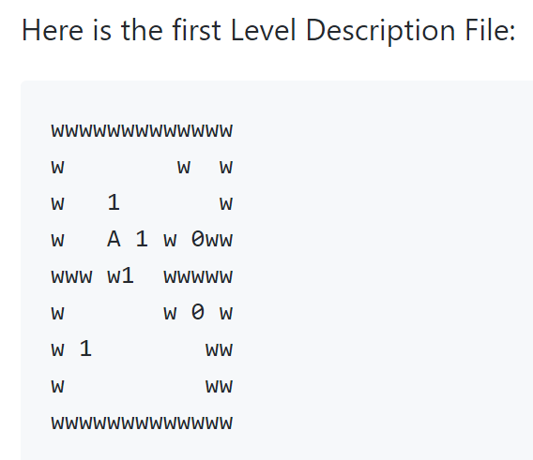
VGDL Example with Level Design https://github.com/EssexUniversityMCTS/gvgai/wiki/VGDL-Language

Slide 20

Vehicle Physics
How do actions affect the movement of the vehicle (space ship)
Left-right?
Car-like?
Asteroids-style space ship
Thrust forward / reverse
Thrust always on? (this is an interesting twist)

Slide 21
Input Controls / Actuator Models
Related to vehicle physics but distinct
How is the ship / game controlled
E.g. Classic arcade versus one tap or one touch (let’s say with one-touch the duration of touch counts too, as well as the timing of the touch)
Can also vary the input mode completely
E.g. Tap-based Pac-Man where each tap gives Pac-Man an aim-point

Slide 22
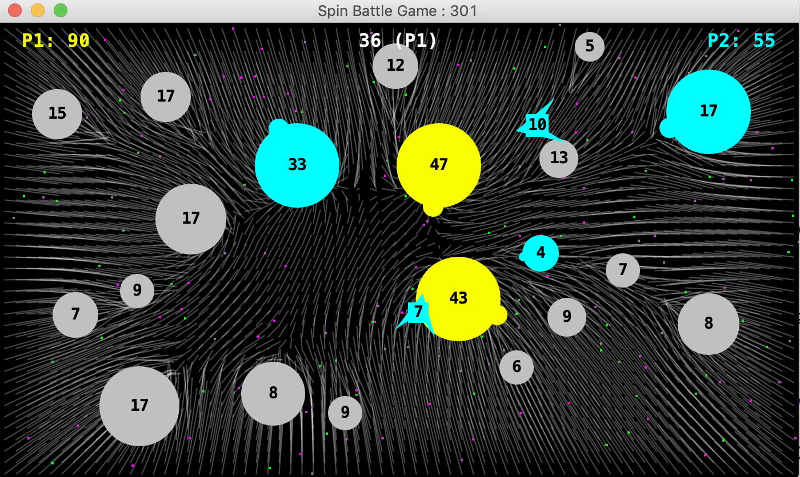
Planet Wars 3 input modes: Slingshot, source-target, catapult

Slide 23
Weapon Systems
Things to vary include:
Firing rate (and cannon cool down)
Missile velocity profile
How fast does it travel
And does it slow down (like a bullet) or speed up (like a rocket)
Missile range
Missile steer
(make ship movement steer the missile – like Galaxians)

Slide 24
Game Views
Fixed versus panning / scrolling / zooming viewport)
2D versus 3D, fully versus partially observable
Note that this can radically alter the nature and difficulty of a game
In game theory terms may also be significant e.g.
Transform a game of perfect information into a partially observable one (and an MDP into a POMDP)
What about Lights-Out Space Battle
Play without seeing anything – except the score!
Actually an already studied game: Kriegspiel

Slide 25
Level Design
This obviously has a significant impact on the difficulty and interest of a game
Ms Pac-Man is a classic example
Where levels differ in maze layouts
And also in the parameters (edible time, speed of Ms Pac-Man and speed of Ghosts)
For Asteroids exercise focus on speed, size and movement (and possibly nature) of the Asteroids

Slide 26
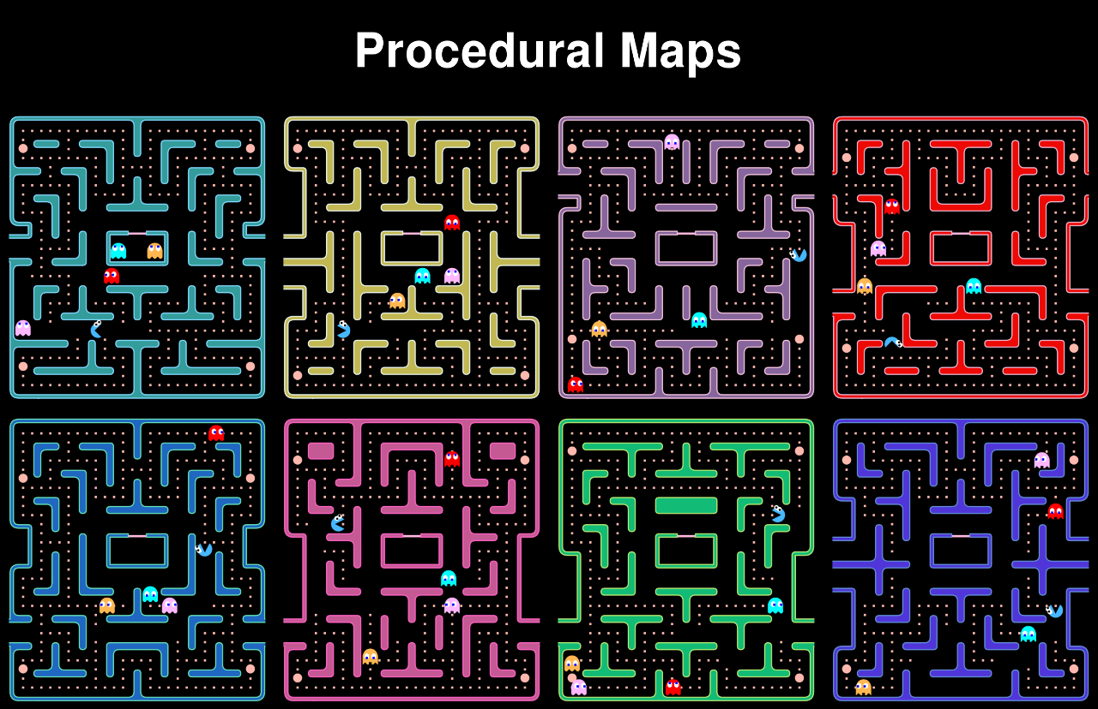
Ms Pac-Man Example

Slide 27
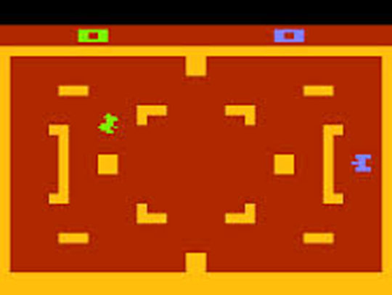
AI Behaviour
This can be a big and complex one
But we’ll experiment with powerful AI on this course
To help manage the complexity
Good AI can make for a very engaging experience – for even a simple battle game
E.g. Atari Tank Battle was brilliant – to play against a human opponent (in this case HI instead of AI)

Slide 28
Summary
Many possible aspects of a game can and probably should be varied
Think in terms of game search spaces
And searching those spaces automatically
At least to weed out non-starters

